Slide 1

Dss(Digital Streaming System) A medium for the database admin to manage the database

Slide 2
DSS- Overview
Registered user
New user?
Login
Register
Authenticated Admin
Movies Catalogue
Actors Catalogue
Reviews Catalogue
C R U D & Search operations
C R U D & Search operations
C R D & Search operations

Slide 3

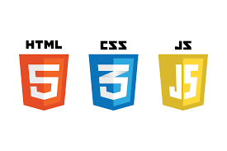





Development tools

Slide 4
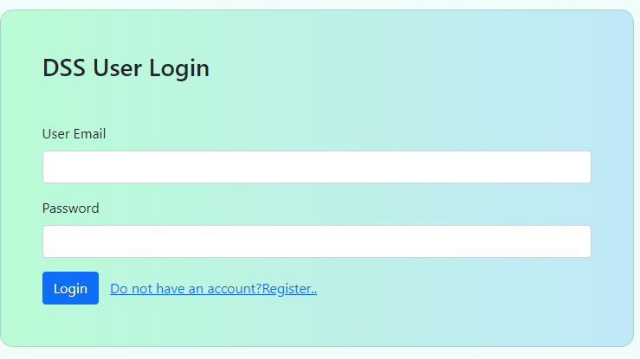
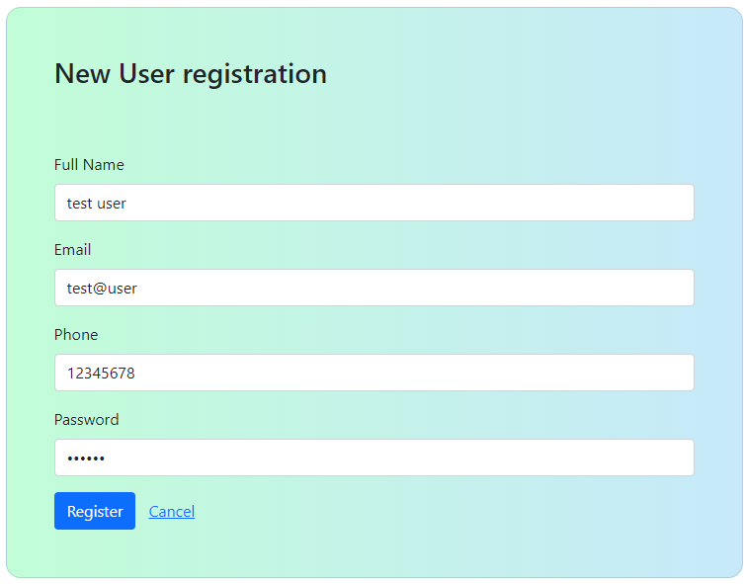
Login & Registration

Slide 5
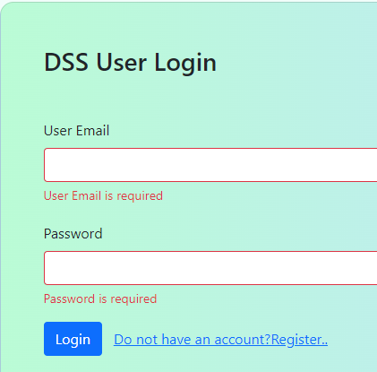
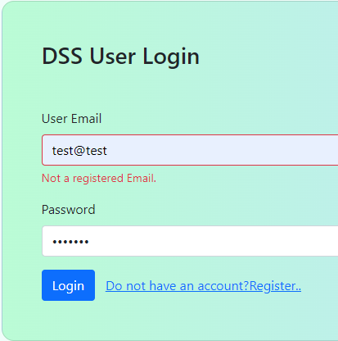
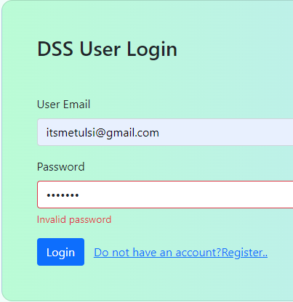
Login & Validations
The login component template contains a login form with user Email and password fields.
It displays validation messages for invalid fields when the submit button is clicked.
The form submit event is bound to the onSubmit() method of the login component.
The component uses reactive form validation to validate the input fields,

Slide 6
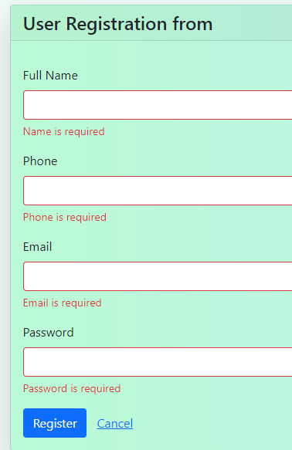
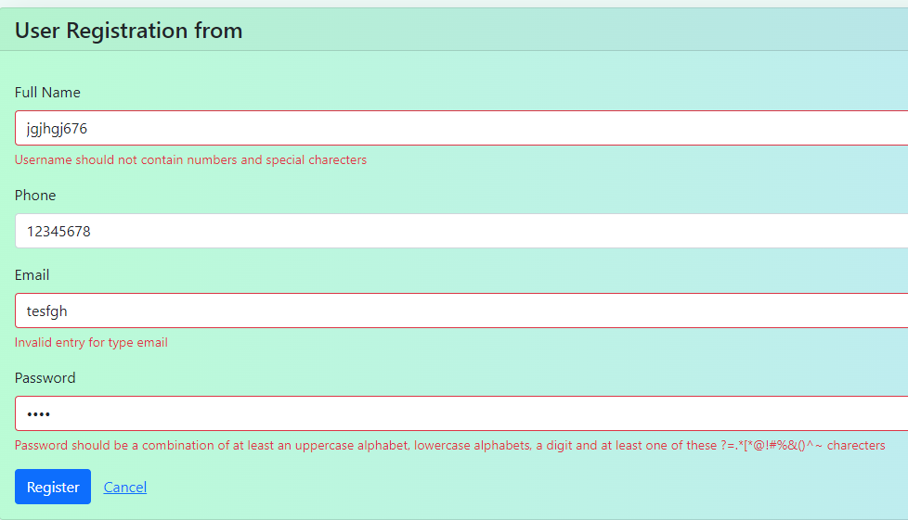

Registration & Input Validations
The Register component template contains a registration form with user Email , password and other fields.
It displays validation messages for invalid fields when the submit button is clicked.
It binds the form submit event to the onSubmit() handler in the register component using the angular event binding (ngSubmit)="onSubmit()"
The component uses reactive form validation to validate the input fields,

Slide 7
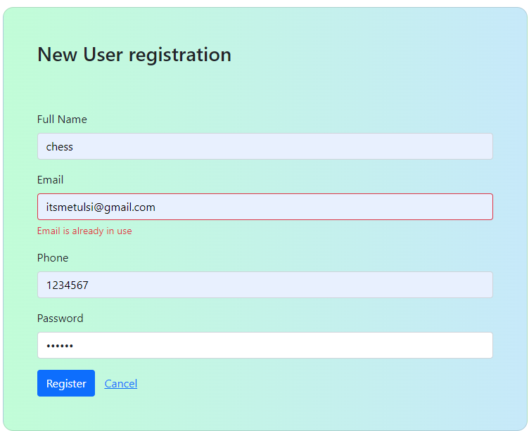
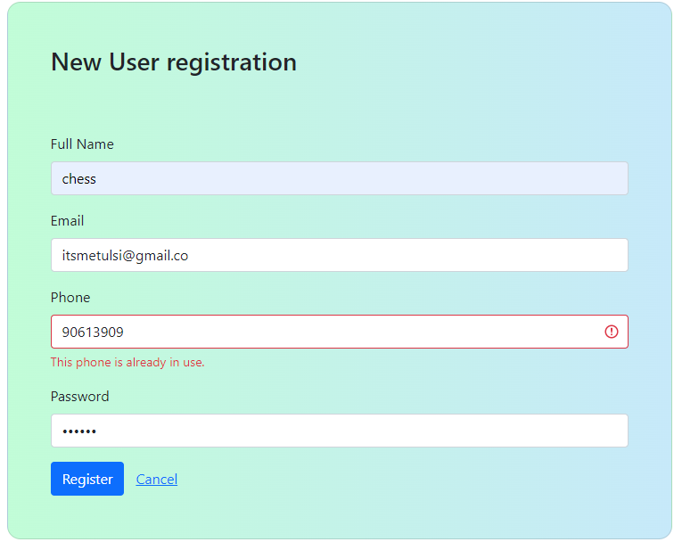
Registration & Input Validations

Slide 8
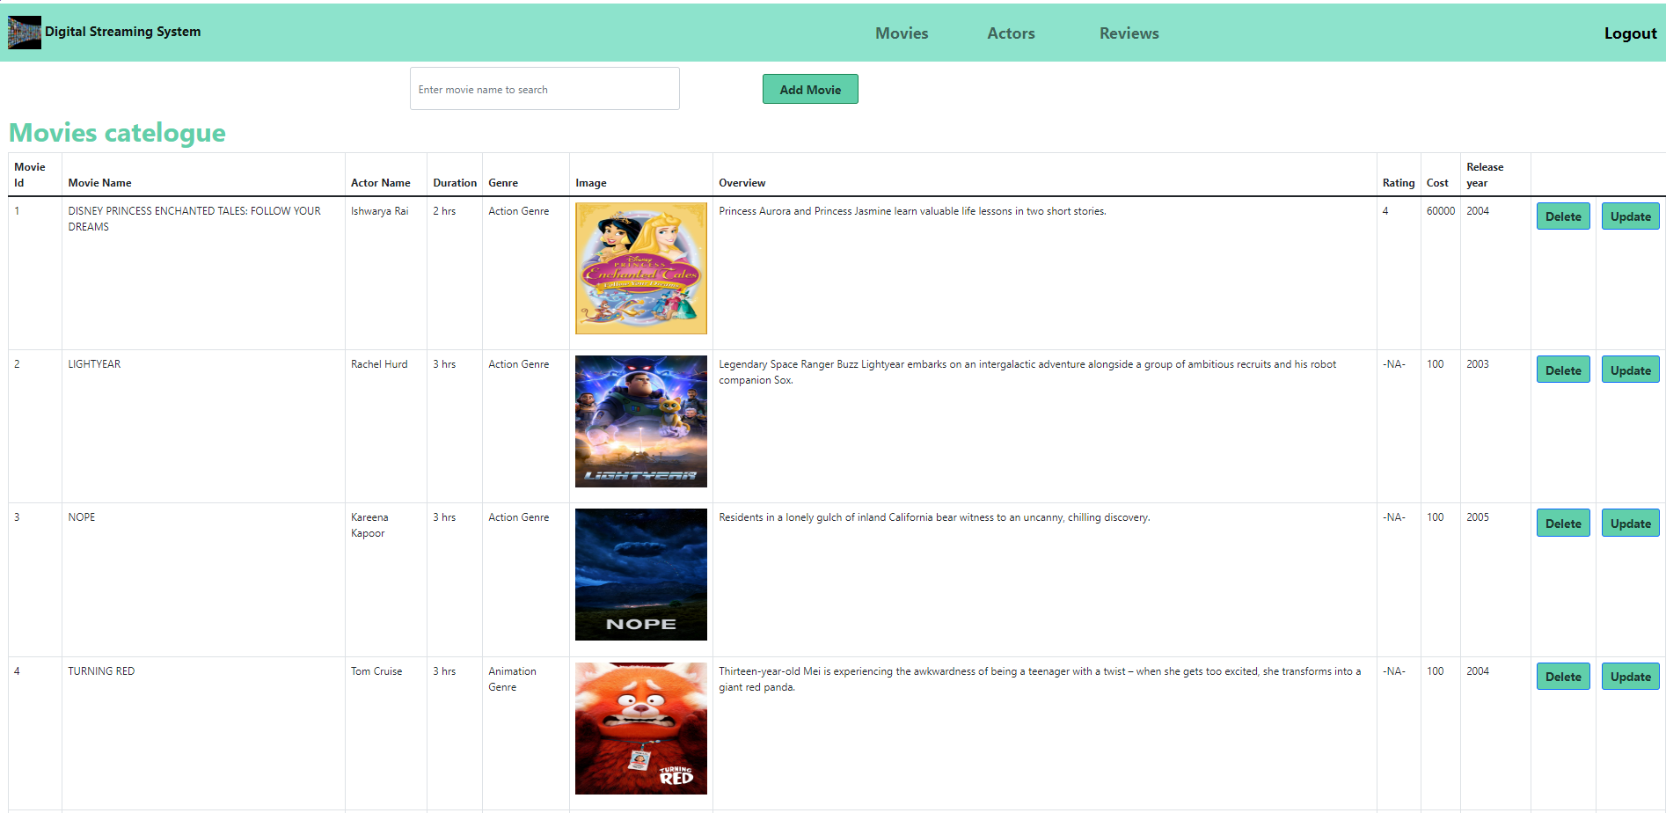
Successful login & Navigate to dashboard
The Movies list component template displays a list of all movies and contains buttons for adding, editing and deleting movies.
The Movies list component gets all movies from the moviesservice in the ngOnInit() angular lifecycle method and makes them available to the movies list template via the movies property.

Slide 9
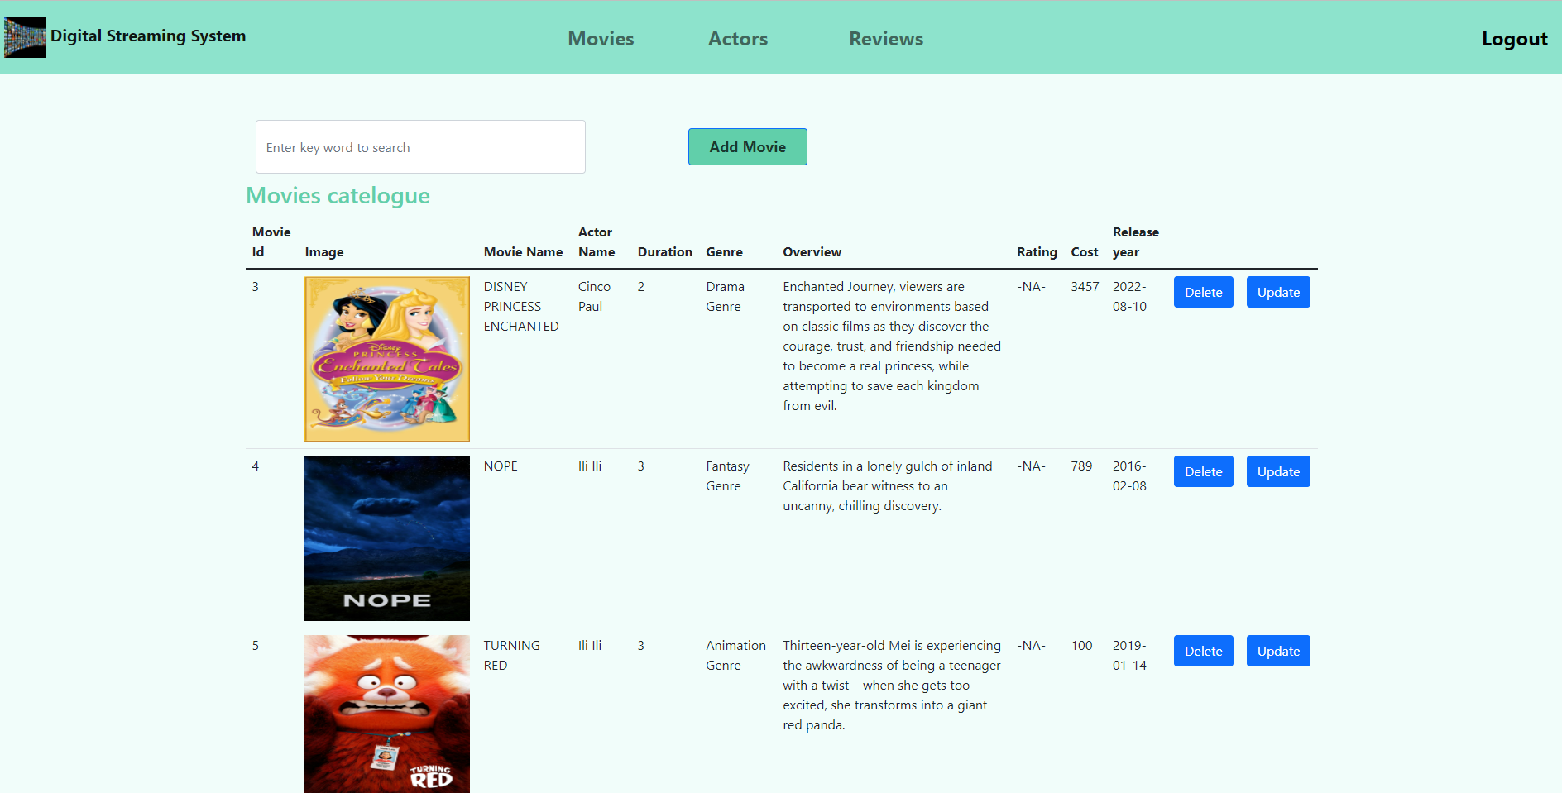
Movies Catalogue
Design considerations:
User friendliness
Clean flow and layout
Clutter free
Delightful experience
Adhering to the requirement document

Slide 10
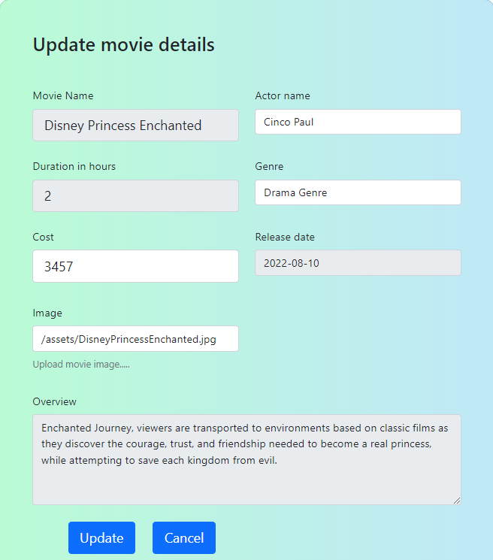
Only the cost and image are editable fields in this form. Cost is validated for positive numbers
Movies Catalogue-Edit movie

Slide 11
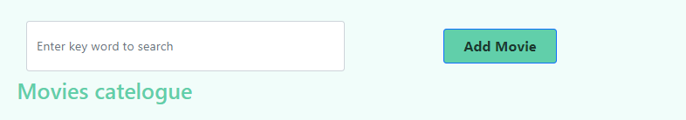
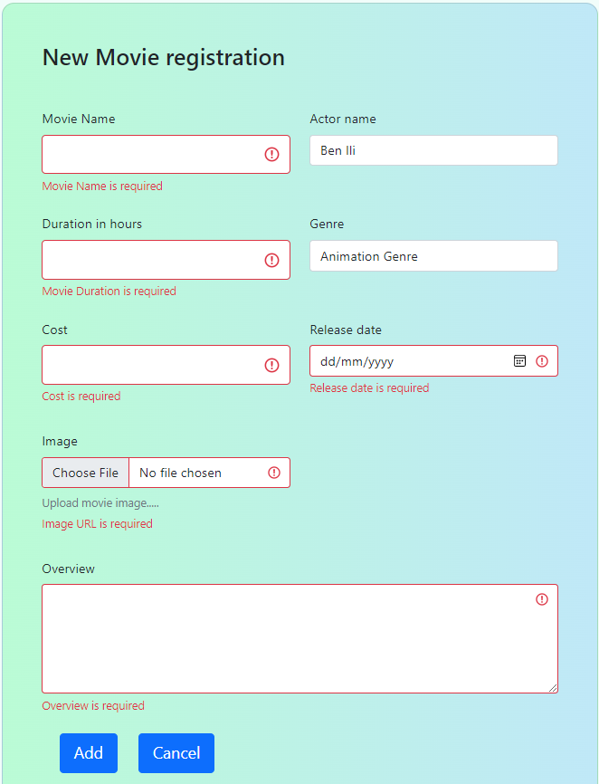
Movies Catalogue-Add movie & search for movie

Slide 12
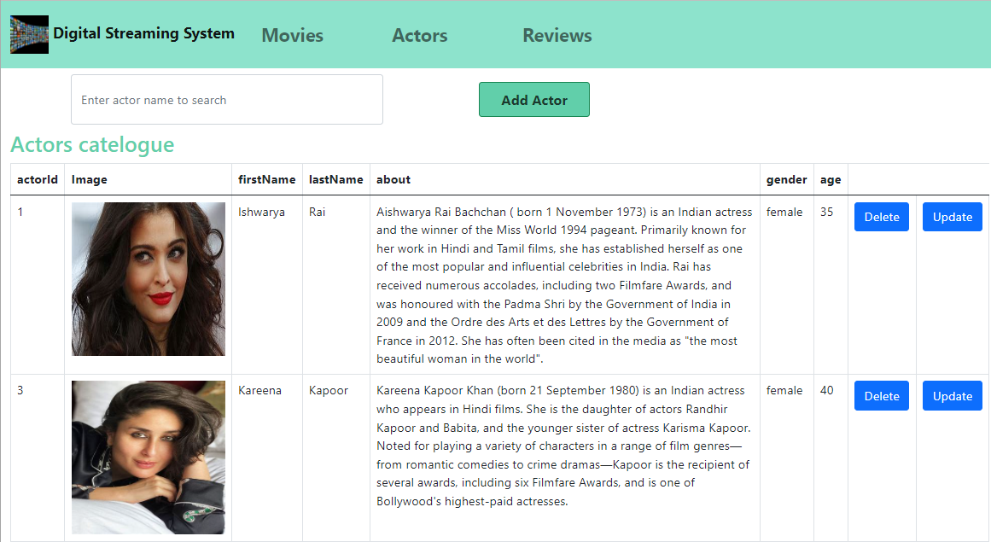
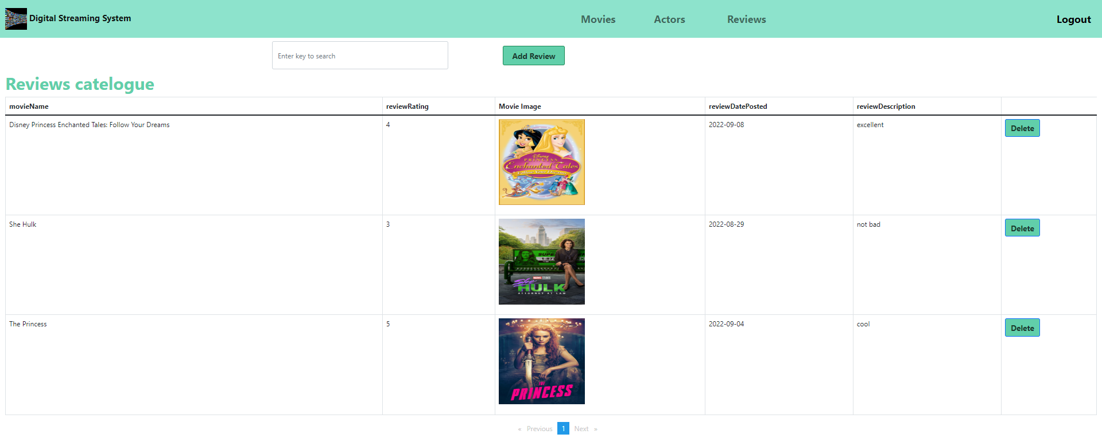
Both catalogs are implemented in a similar fashion. Let’s see the live application demo
Actors and reviews catelogues

Slide 13
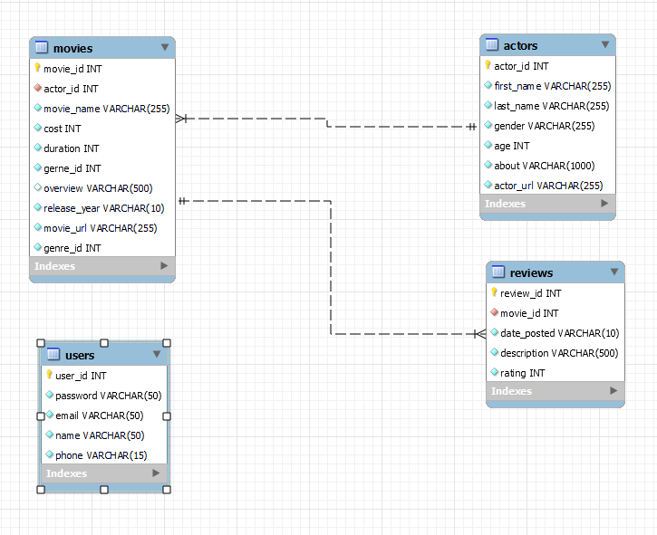
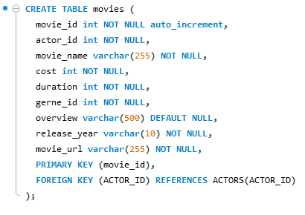
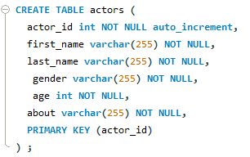
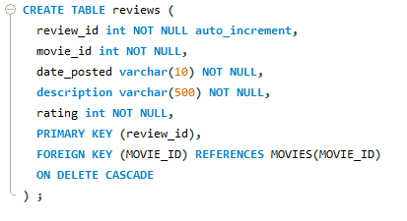
MySql Database Table design

Slide 14
Code walk through……..

Slide 15
work flow in angular application
Browser
HTML Template
Component
Service
REST API

Slide 16
Questions??

